Slide 1
Insight Engineer Case Study
Streamifiably

Slide 2
Overview
Company Background:
You are working as an Insights Engineer for Streamifiably, a leading streaming TV platform. Streamifiably offers live TV channels, a vast library of on-demand content, and a personalized viewing experience for customers. As the Insights Engineer, you play a critical role in leveraging data analytics to drive product improvements and deliver exceptional value to users.
The Challenge:
The product team has handed off a set of analytics requirements in the form of user events and tests that need to be implemented by the development team. However, the developers are facing issues while implementing the events. Because of this, the developers are not able to reliably pass the tests. As the Insights Engineer, you need to work with the cross-functional team to resolve this issue and ensure the analytics implementation meets the business requirements.

Slide 3
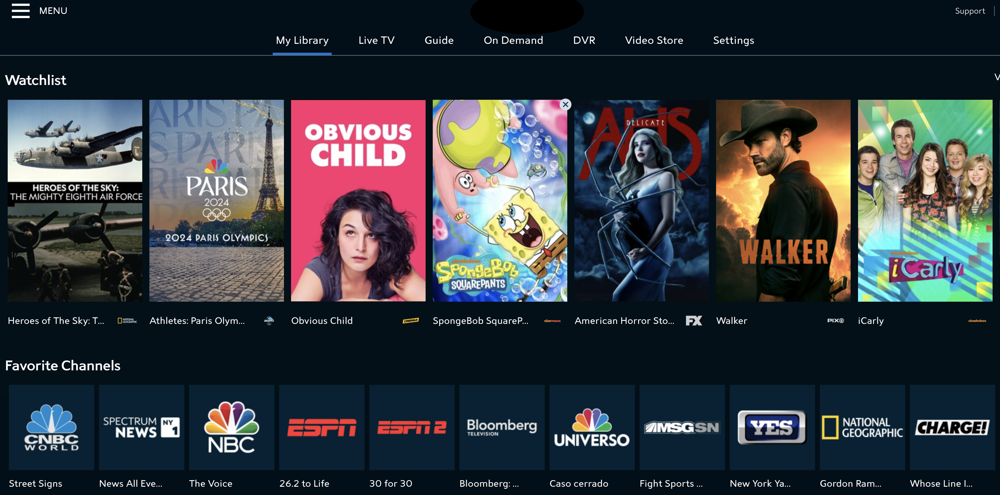
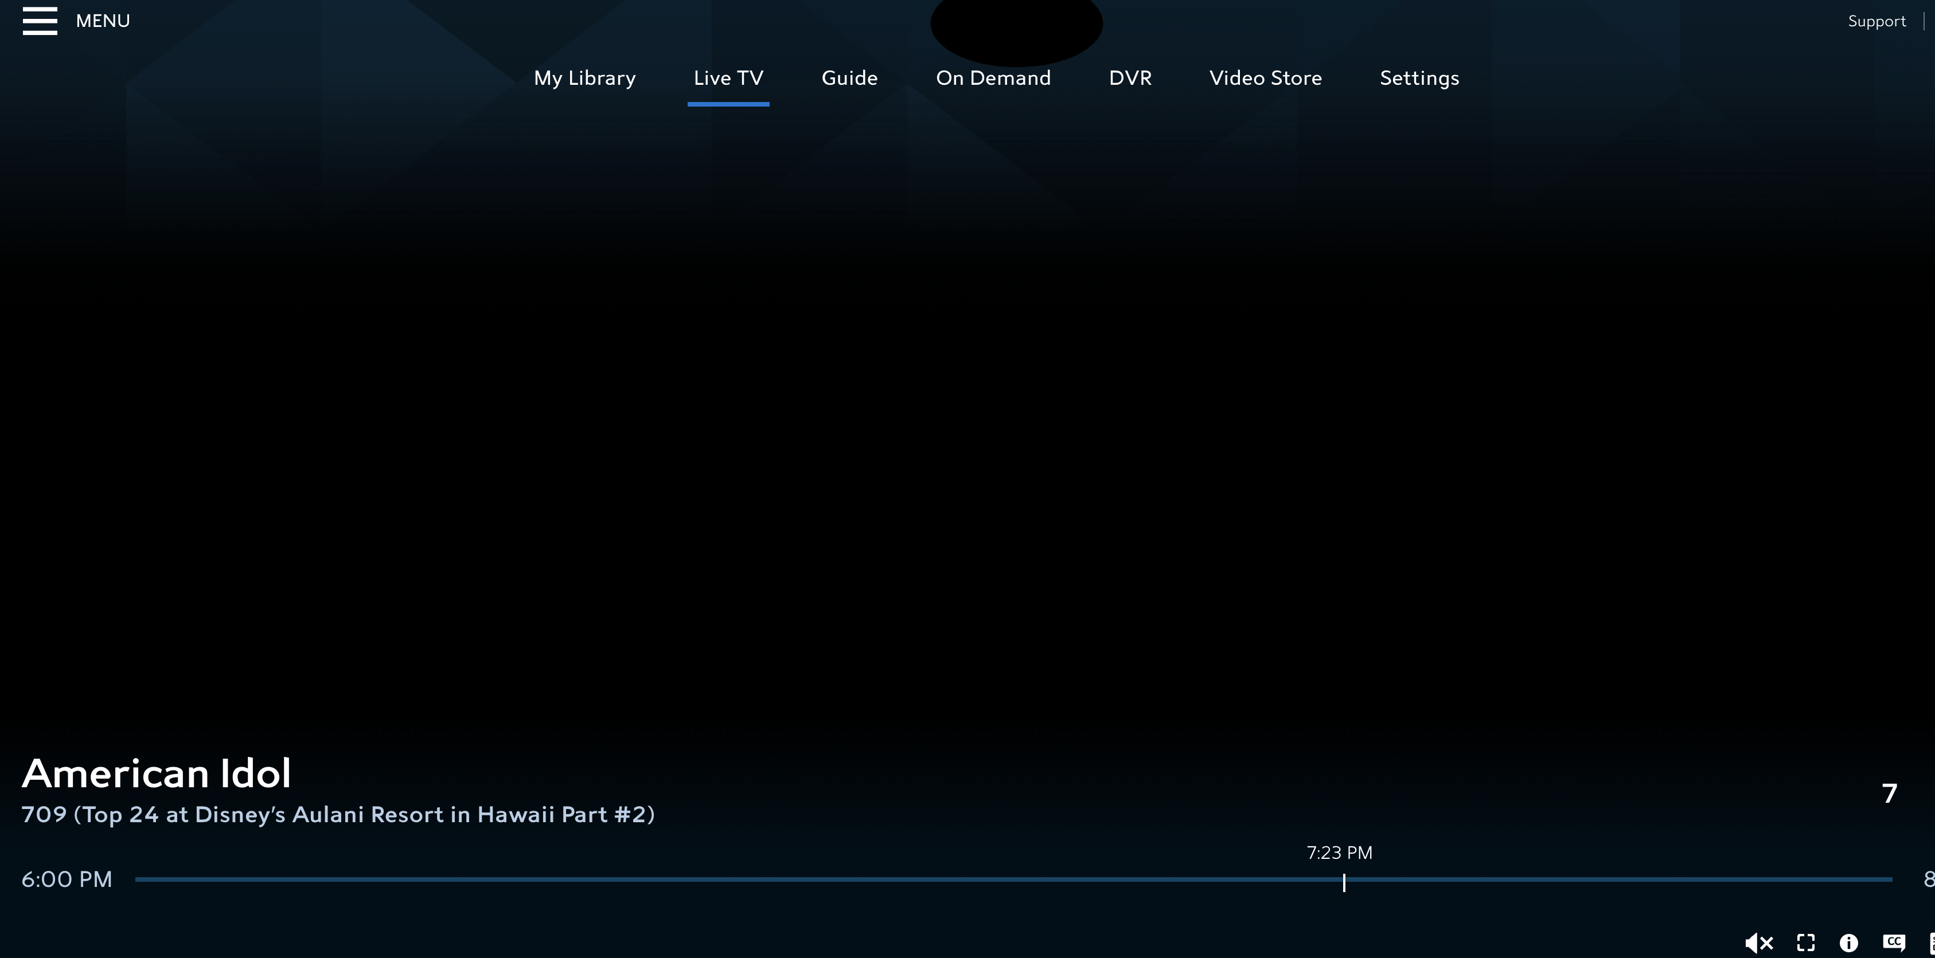
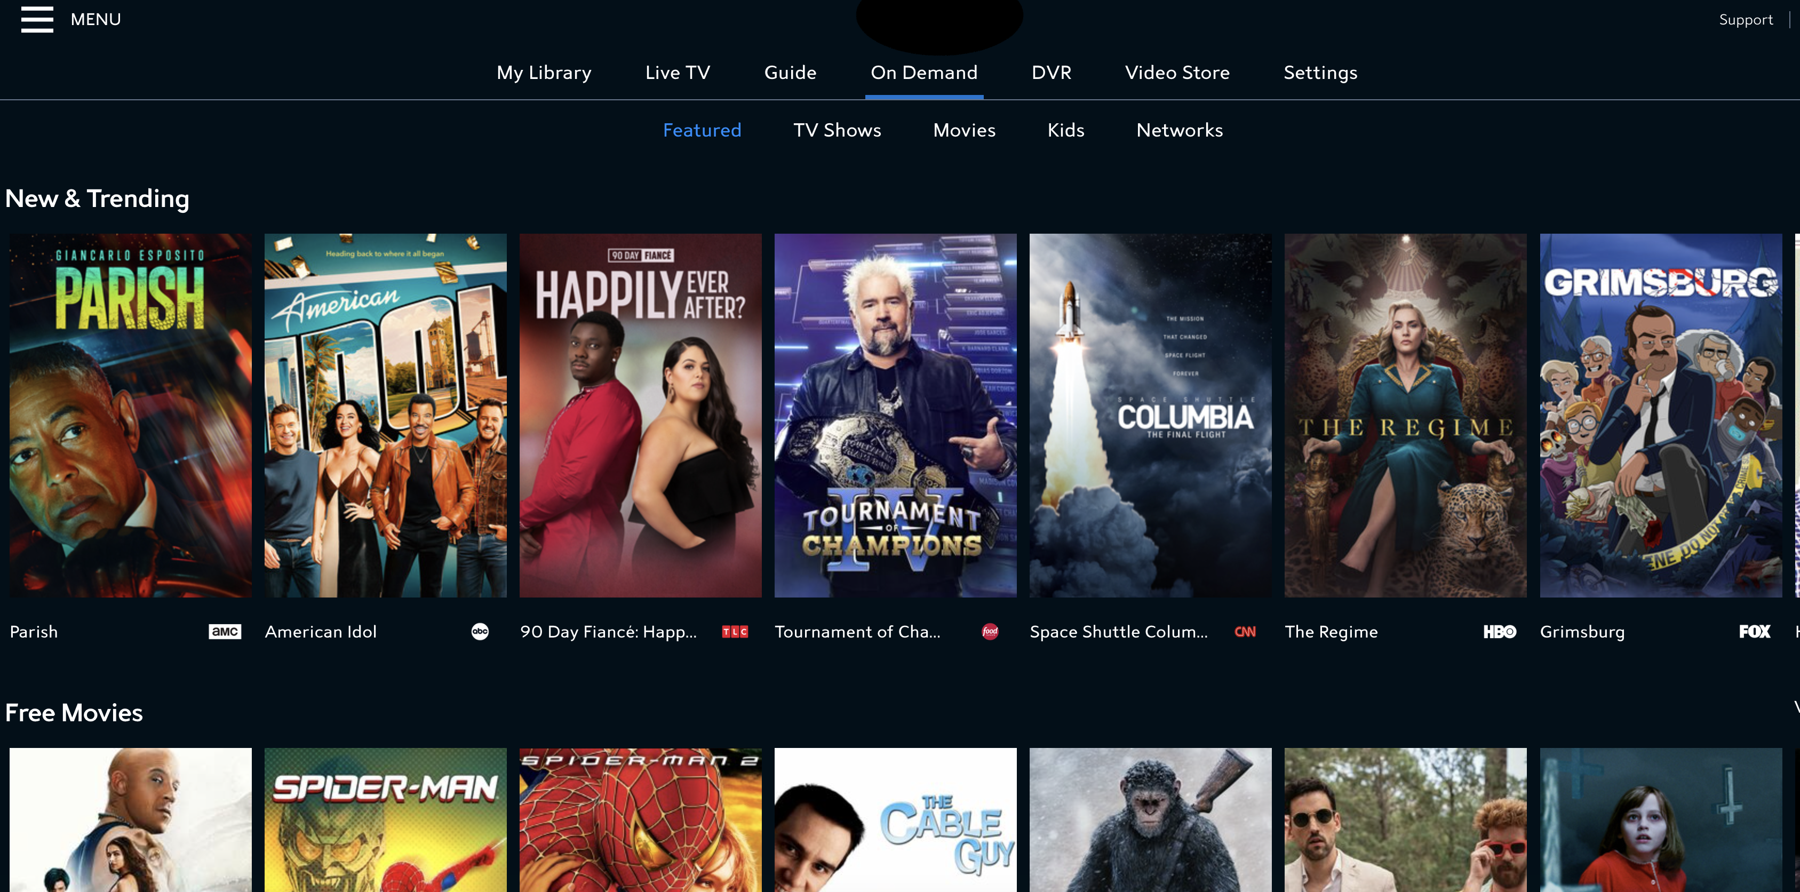
Streamifiably - Application Overview
My Library: This is the "My Library" section of the Streamifiably app, where users can see their recently watched shows, favorite channels, and their watchlist.
Live TV: The "Live TV" section displays live content for the user has selected to watch. (pretend that there is content playing, you are seeing a black screen because DRM laws)
Questions:
Walk through the key sections of the Streamifiably app, as shown in the screenshots. Think about the type of data and metrics that would be important to capture from a business owner's perspective for each section.
Define 2-3 events and what data you want to capture within those events for each of the sections.
Write a test case the developers can use to validate that the events you created are firing in the right order. Use plain language to tie the test steps to the events.
On-Demand: The "On-Demand" section features various content categories and swimlanes, making it easy for users to discover and access on-demand movies, TV shows, and other content.

Slide 4
Answer the following questions:
Describe your experience working with cross-functional teams, particularly with developers. Provide an example of how you would approach the current issue where the developers are struggling to make the tests pass reliably.
Discuss any data points or events you would want to capture that are not directly related to user interaction. Explain the purpose and importance of monitoring these backend metrics. Define 1 event with example data points you would want to capture on that event.
Demonstrate your understanding of version control systems like Git. Describe the key Git commands and their use cases, and explain why version control is critical for software development projects.
Explain the concept of "persistence" as it relates to data. Differentiate between data points that should persist throughout a user session versus those that should not.

